Slide 1

WAY TO ENTERPRISE
AWS
VTI ACADEMY
Author: duy.nguyenngoc1@vti.com.vn

Slide 2
Agenda
Simple Queue Service
Simple Notification Service
Kinesis Service
Single Sign-On Service
Cognito Service
Assignments
Quiz
Copyright © VTI Academy All Rights Reserved

Slide 3
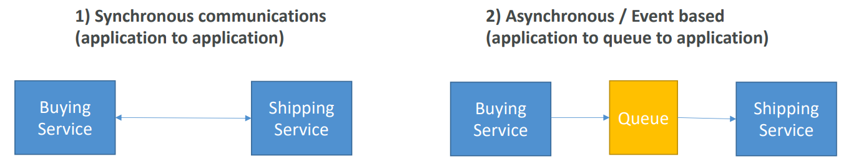
Integration & Messaging
When we start deploying multiple applications, they will inevitably need to communicate with one another
There are two patterns of application communication

Slide 4
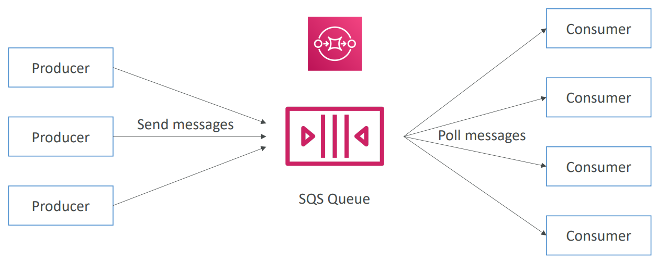
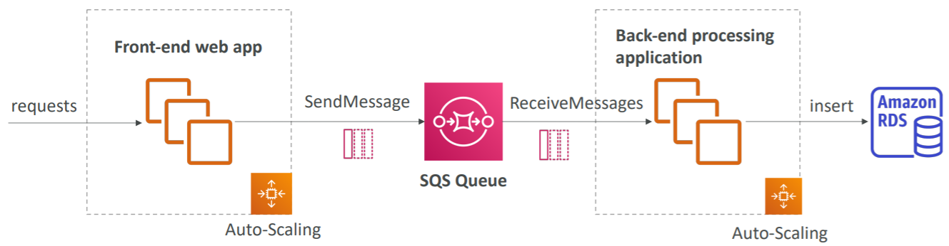
Simple Queue Service
Is a service that allows saving Queue on AWS
Usecases
  Used to decouple applications
  Processing each payment request
Price: https://aws.amazon.com/sqs/pricing/
Tutorial: https://docs.aws.amazon.com/AWSSimpleQueueService/latest/SQSDeveloperGuide/welcome.html

Slide 5
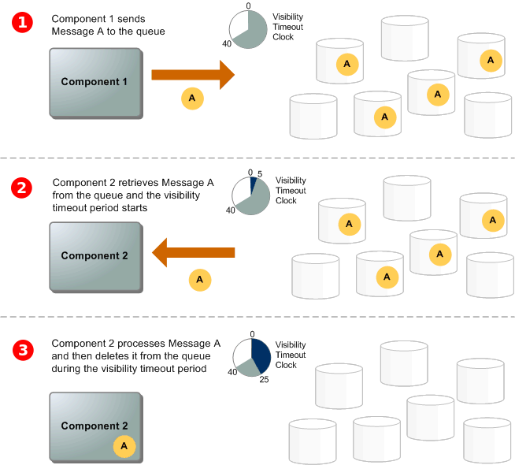
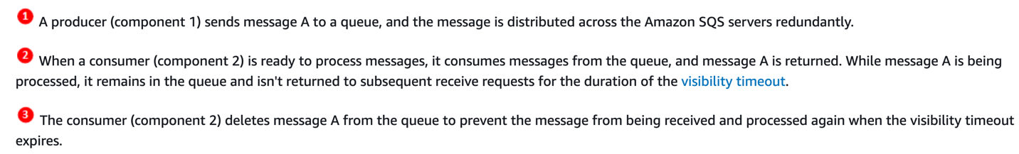
Route53 Service
Flow

Slide 6
Simple Queue Service
Demo
  Create Standard Queue
  Send message
  Receive message
  Remove message from Queue
  Send & Receive multiple messages
  Remove all message in Queue

Slide 7
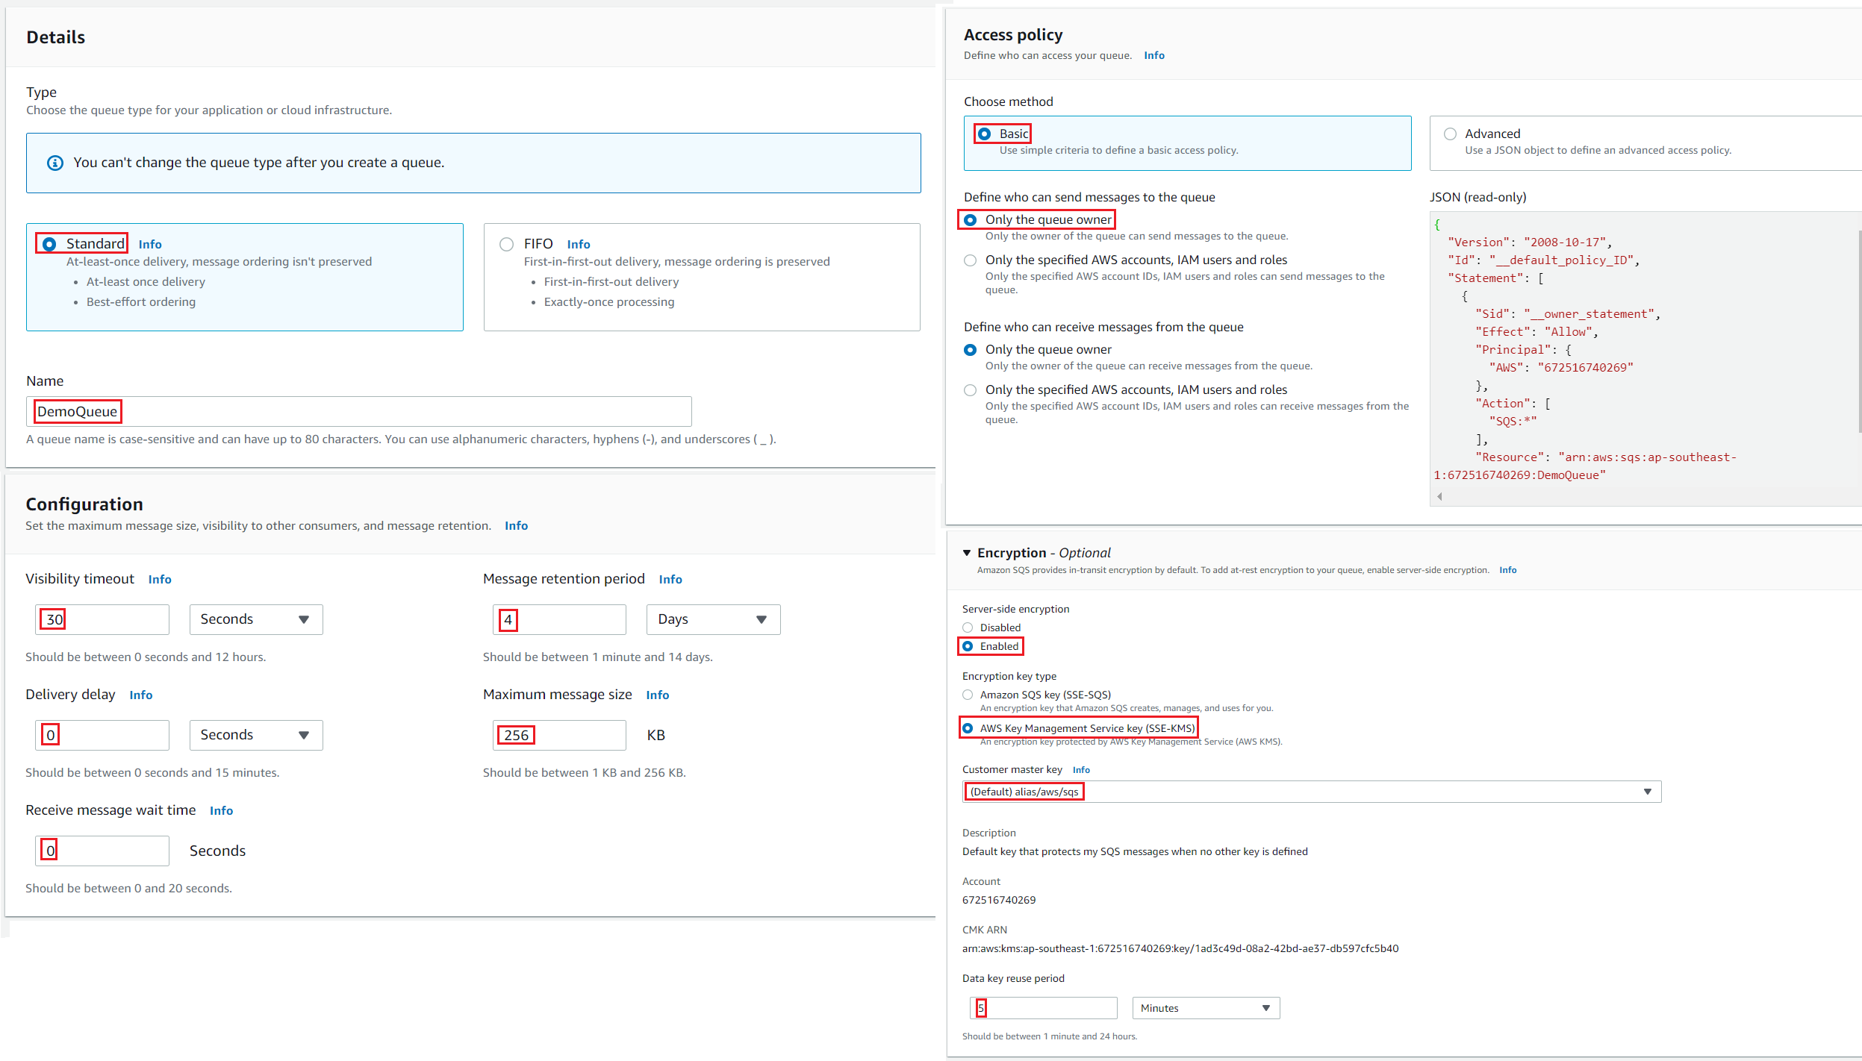
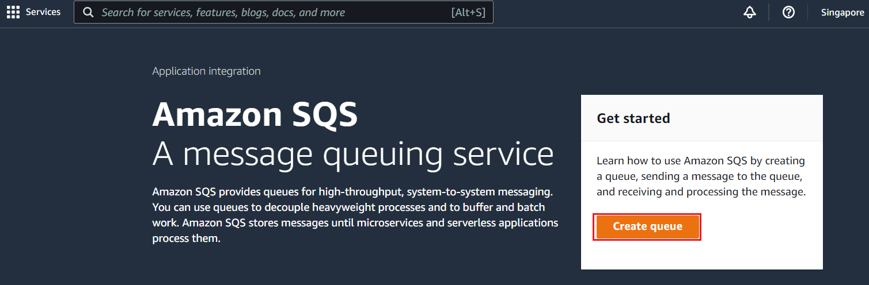
Simple Queue Service
  Create Standard Queue

Slide 8
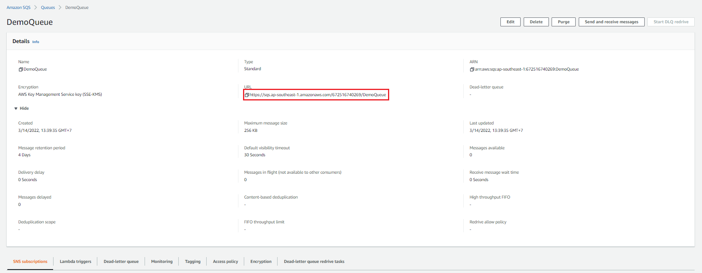
Simple Queue Service

Slide 9
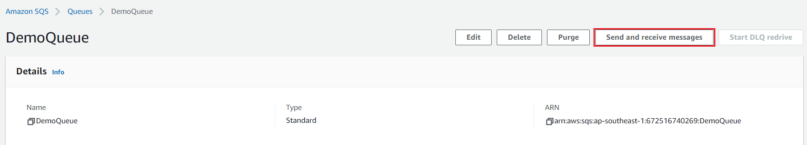
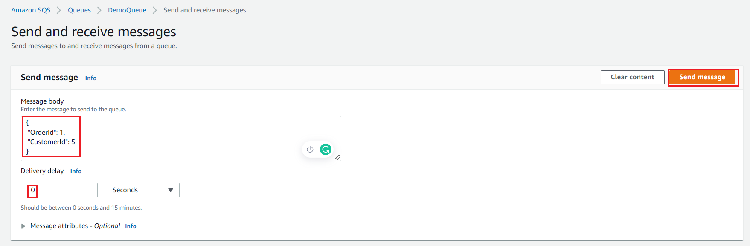
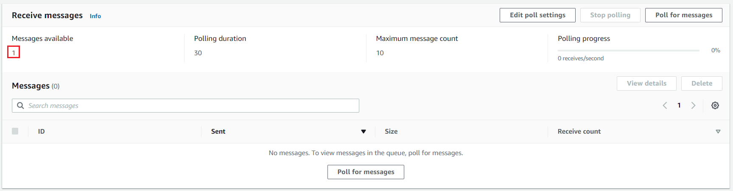
Simple Queue Service
  Send message (Using Console)

Slide 10
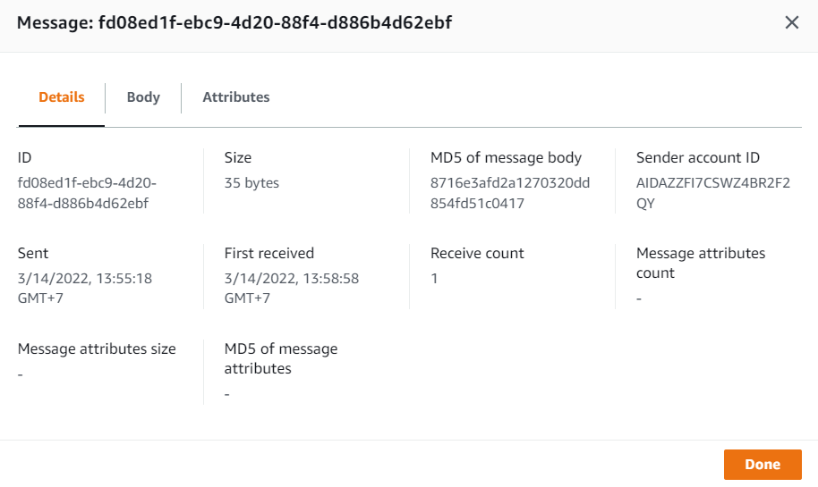
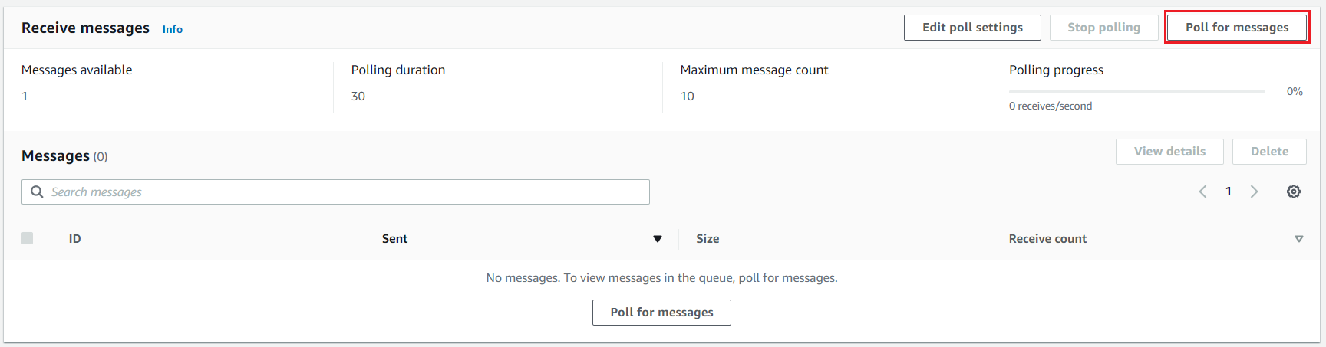
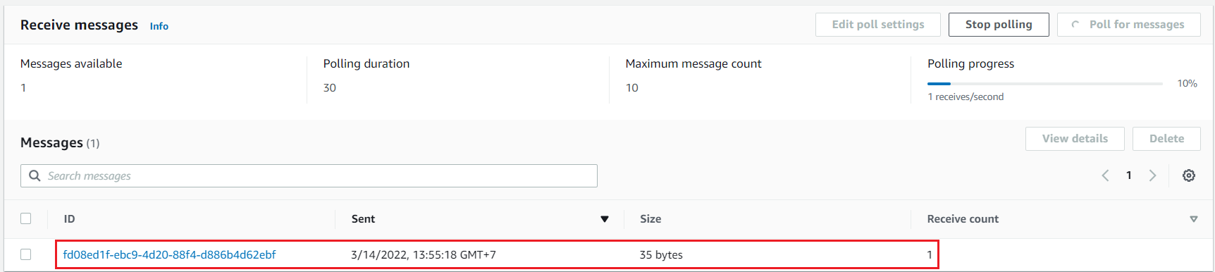
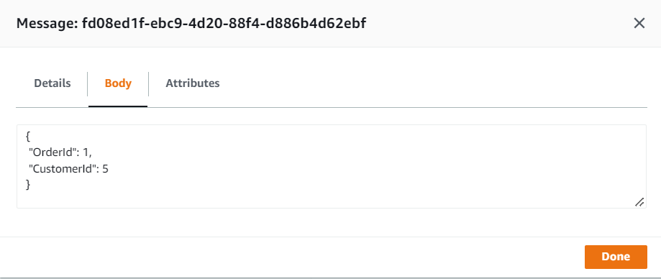
Simple Queue Service
  Receive message (Using Console)

Slide 11
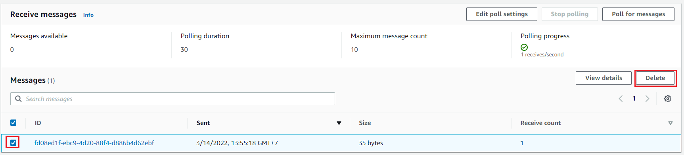
Simple Queue Service
  Remove message from Queue (Using Console)
That means the message has been successfully processed

Slide 12
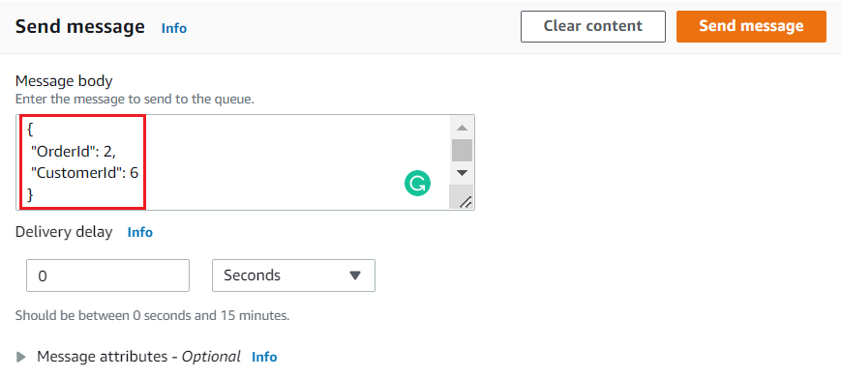
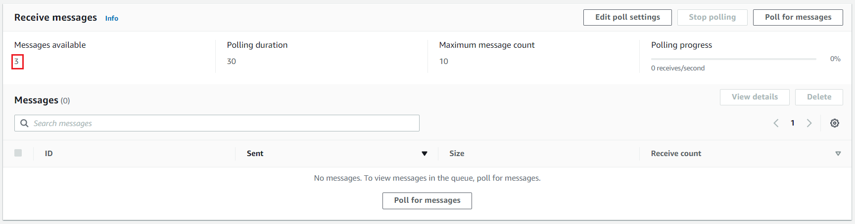
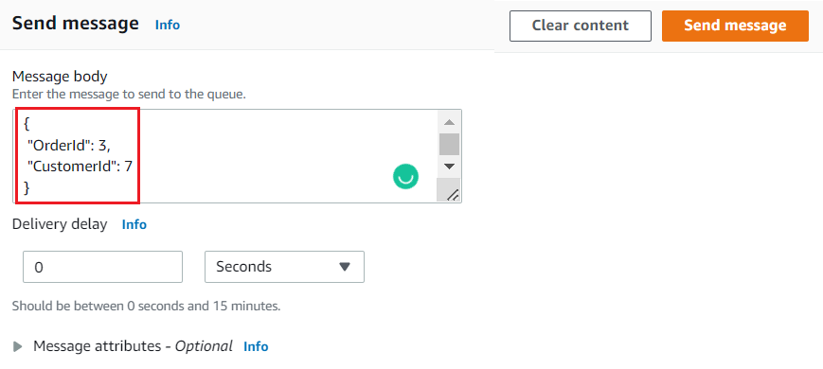

Simple Queue Service
  Send & Receive multiple messages
Send multiple messages

Slide 13
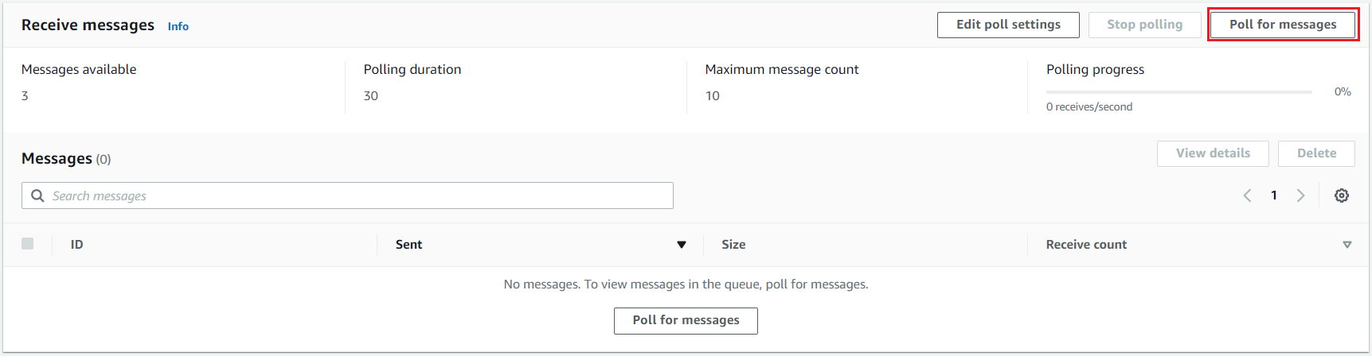
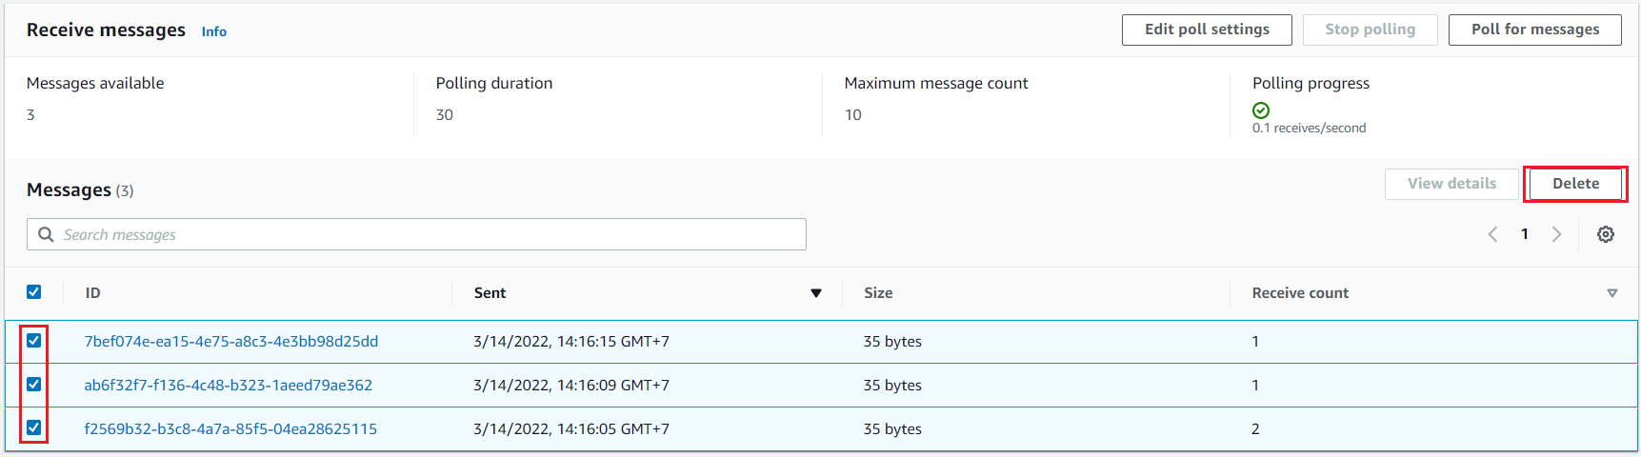
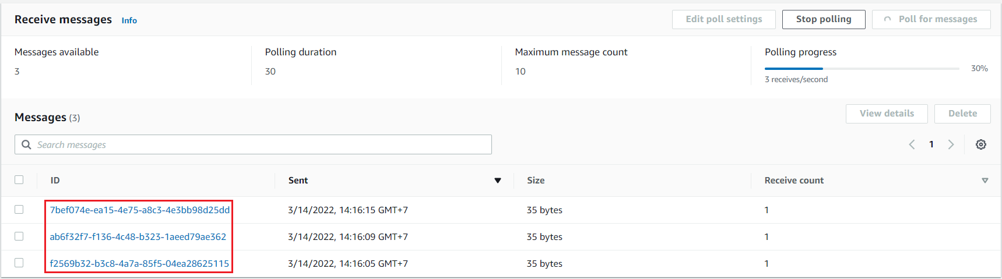
Simple Queue Service
Remove message from Queue
That means the message has been successfully processed
Receive multiple messages

Slide 14
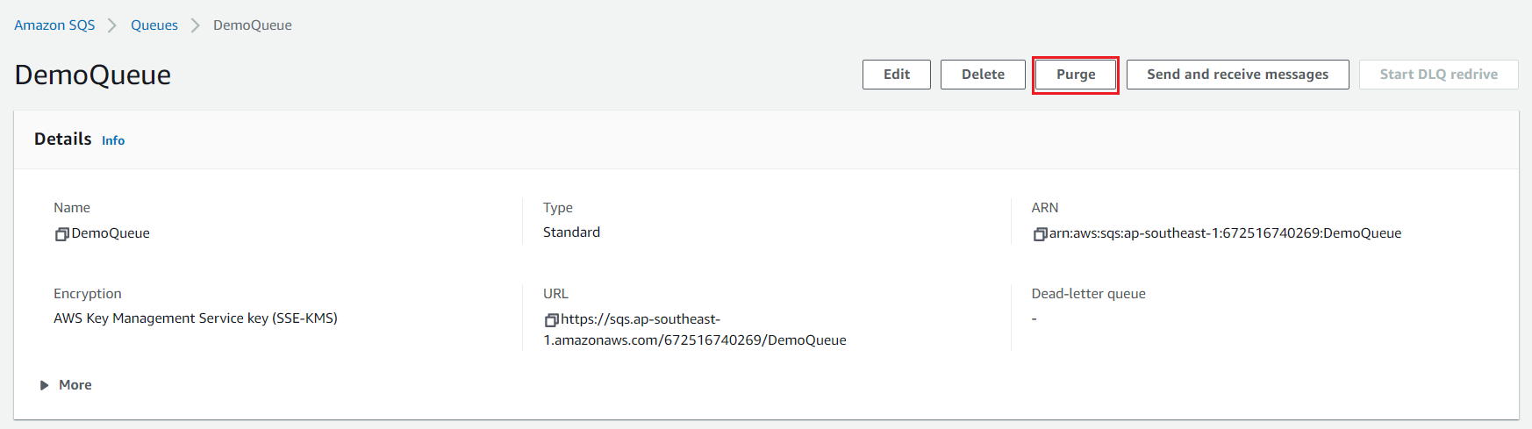
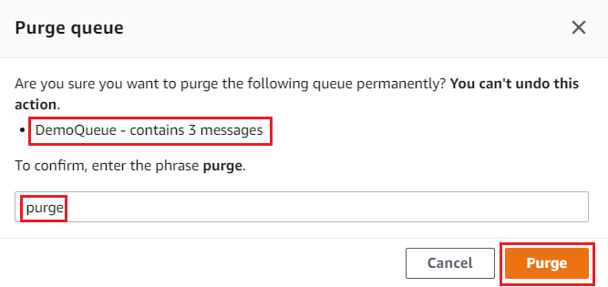
Simple Queue Service
  Remove all message in Queue

Slide 15
Simple Queue Service
Demo 2: Create queue, send & receive message via SDK
  https://www.youtube.com/watch?v=-wNqE4n32zQ

Slide 16
Assignment
  Self-practice

Slide 17
Simple Queue Service
Components
  Producer
  Consumer
  Message
  Queue
  Security

Slide 18
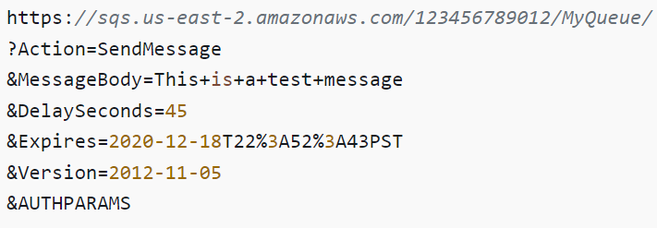
Simple Queue Service
  Producer
    Create messages and send it to SQS using the SDK (SendMessage API)
Send message using Console
SDK (Tutorial: Link)

Slide 19
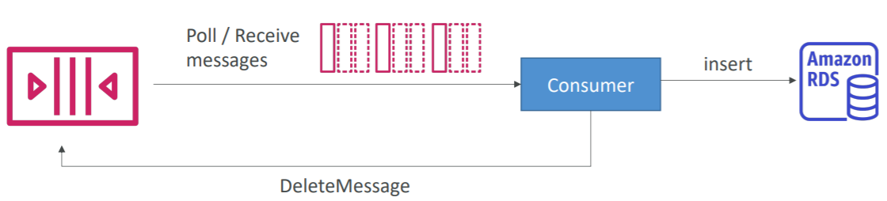
Simple Queue Service
  Consumer
    Consumers running on EC2 instances, on-premises servers, AWS Lambda, …
    Poll SQS for messages (receive up to 999 messages at a time)
    Process the messages (Ex: insert the message into an RDS database)
    Delete the messages after processing messages (using the DeleteMessage API)

Slide 20
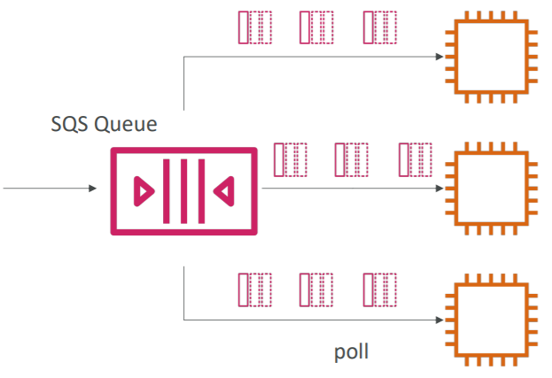
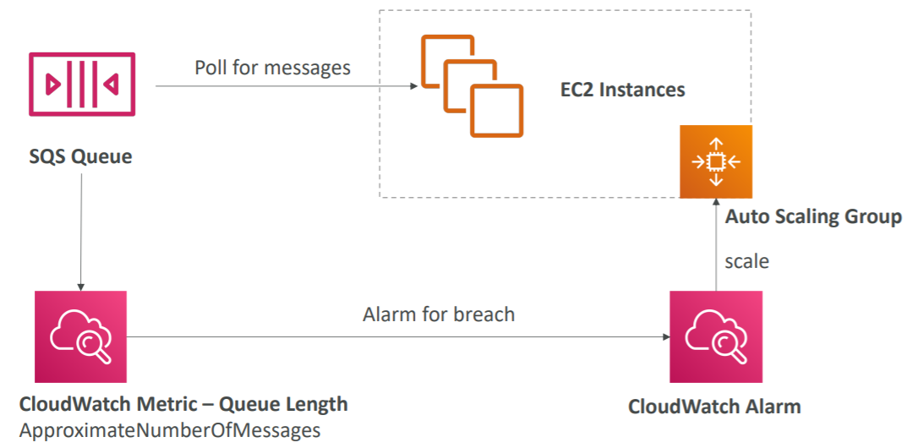
Simple Queue Service
    Multiple EC2 Instances Consumers
      Consumers receive and process messages in parallel
      You can scale consumers horizontally to improve throughput of processing
SQS with Auto Scaling Group
SQS to decouple between application tiers

Slide 21
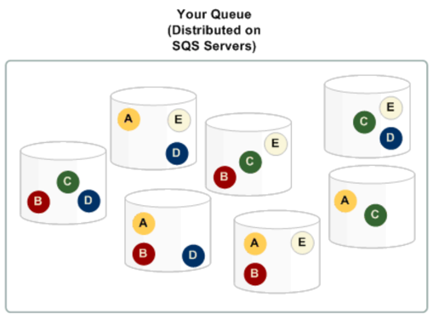
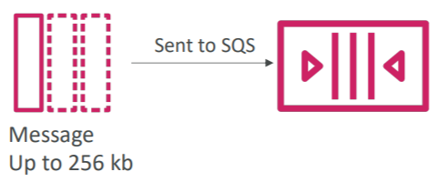
Simple Queue Service
  Message
    The message is persisted in SQS until a consumer deletes it
    Stored on multiple SQS servers
Example: send an order to be processed, including Order id, Customer id, ...

Slide 22
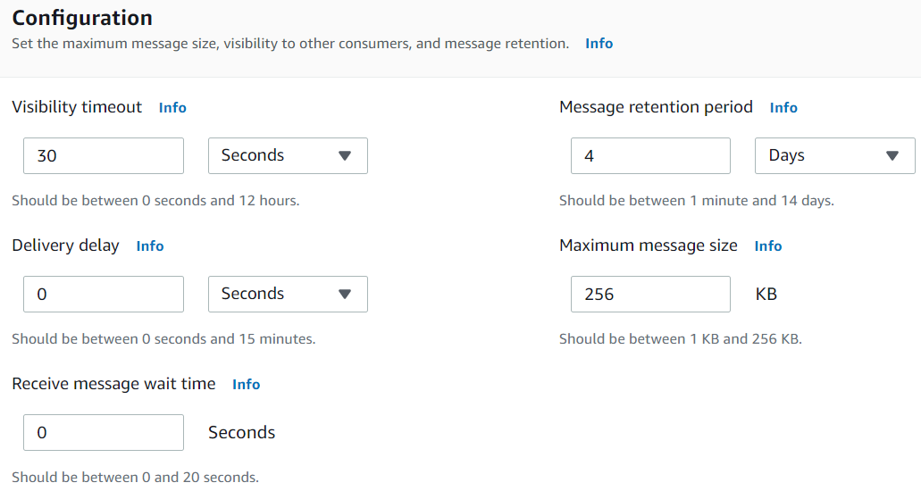
Simple Queue Service
    Settings
      Message Visibility Timeout
      Dead Letter Queue
      Delay Queue
      Long Polling
      Message retention

Slide 23
Simple Queue Service
    Message Visibility Timeout
      Is time taken by a consumer to receive and process message
      After a message is polled by a consumer, it becomes invisible to other consumers
      By default, the Message Visibility Timeout is 30 seconds, that means the message has 30 seconds to be processed
      After the message visibility timeout is over, the message is visible in SQS
      If a message is not processed within the visibility timeout, it will be processed twice
      If visibility timeout is high (hours), and consumer crashes, re-processing will take time
      If visibility timeout is too low (seconds), we may get duplicates

Slide 24
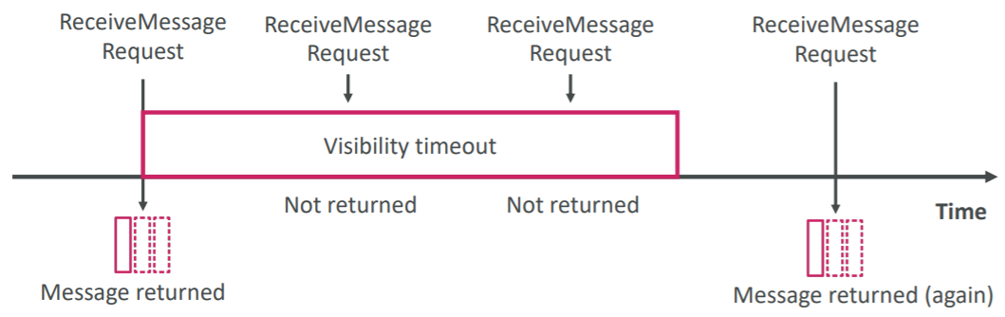
Simple Queue Service

Slide 25
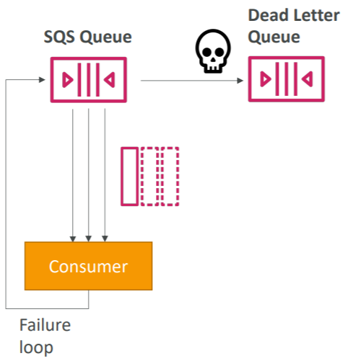
Simple Queue Service
    Dead Letter Queue
      If a consumer fails to process a message within the Visibility Timeout time 🡺 the message goes back to the queue!
      You can set a threshold of how many times a message can go back to the queue
      After the MaximumReceives threshold is exceeded, the message goes into a dead letter queue (DLQ)
      Useful for debugging!
      Make sure to process the messages in the DLQ before they expire
      Good to set a retention of 14 days in the DLQ

Slide 26
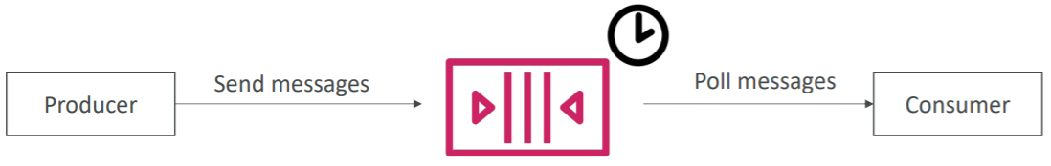
Simple Queue Service
    Delay Queue
      Delay a message (consumers don’t see it immediately) up to 15 minutes
      Default is 0 seconds (message is available right away)

Slide 27
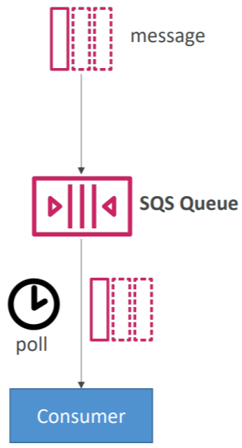
Simple Queue Service
    Long Polling
      When a consumer requests messages from the queue, it can optionally “wait” for messages to arrive if there are none in the queue, this is called Long Polling
      LongPolling decreases the number of API calls made to SQS while increasing the efficiency and latency of your application
      The wait time can be between 1 sec to 20 sec (20 sec preferable)
      Long Polling is preferable to Short Polling
      Long polling can be enabled at the queue level or at the API level using WaitTimeSeconds

Slide 28
Simple Queue Service
    Message retention
      Is time the message is stored in the queue
      Default 4 days, up to 14 days
    Maximum message size
    ...

Slide 29
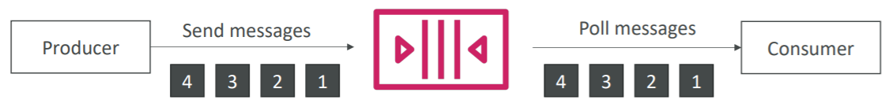
Simple Queue Service
  Queue
    2 types
      Standard queue (default)
        Get random messages
        At-least-once message delivery
        Usecases: Upload media while resizing or encoding it
        Unlimited throughput, unlimited number of messages in queue
        Low latency (<10 ms on publish and receive)
        Limitation of 256KB per message sent
      FIFO Queue (First In First Out Queue)
        Messages are processed in order by the consumer
        Exactly-once message delivery
        Usecases: order product
        Limited throughput: 300 msg/s 🡺 3000 msg/s
FIFO Queue

Slide 30
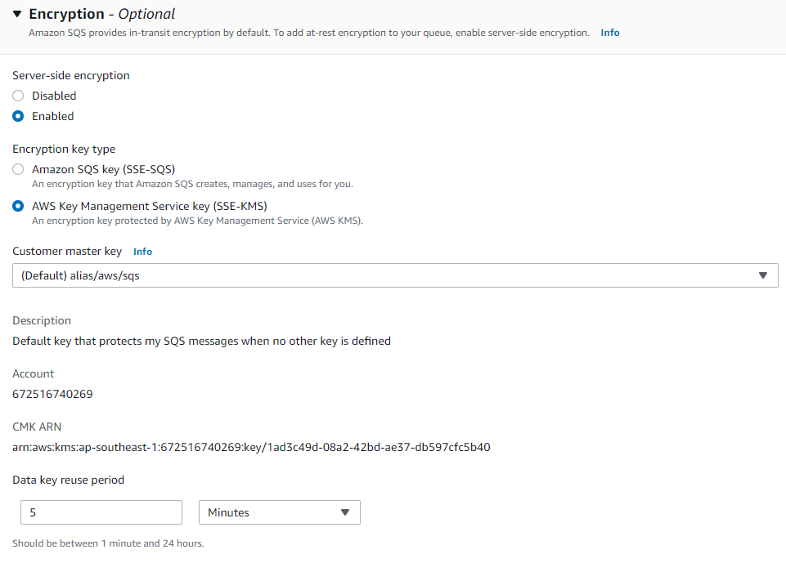
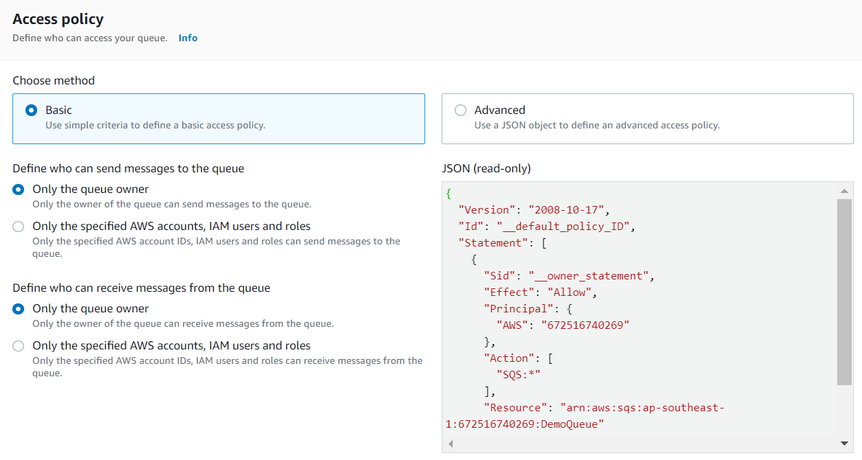
Simple Queue Service
  Encryption
    In-flight encryption: using HTTPS API
    At-rest encryption: using KMS keys
    Support client-side encryption if the client wants to perform encryption/decryption itself
  Access Controls & SQS Access Policies
    IAM policies to regulate access to the SQS API
    Support cross-account access

Slide 31
Simple Queue Service
  Support SNS & Lambda Function (Next lessons)

Slide 32
Assignment
  Self-practice

Slide 33
Summary
Is a service that allows saving Queue on AWS
Usecases: used to decouple applications, processing each payment request
Components: Producer, Consumer, Message, Queue
Producer: Create messages and send it to SQS using the SDK
Consumer
  Is EC2 instances, on-premises servers, AWS Lambda, …
  Process the messages
  Support Auto Scaling Group

Slide 34
Summary
Message
  Settings: Message Visibility Timeout, Dead Letter Queue, Delay Queue, Long Polling, Message retention, ...
  Delete the messages after processing messages
Queue
  2 types: Standard Queue, FIFO Queue
Encryption: In-flight, At-rest, client-side
Access Controls & SQS Access Policies
Support SNS & Lambda Function (Next lessons)

Slide 35
Q & A
Copyright © VTI Academy All Rights Reserved

